Slide 1
THE BIOSYNTHESIS OF FATTY ACIDS AND RELATED COMPOUNDS
Fatty acids synthesis is the major way of utilizing excess dietary carbohydrates.
Fatty acid synthesis occurs mainly in the adipose tissue and the liver.
Other sites where de novo (from scratch) synthesis of fatty acids take place are lactating mammary glands, lungs and the renal cortex.
Synthesis and degradation of fatty acids are similar in that they involve a cycle of reactions that change the length of the substrate by two carbon atoms at a time.

Slide 2
CONT’
However, they differ from each other in several aspects:
Fatty acid synthesis occurs in the cytosol, whereas β-oxidation occurs in the mitochondria. This makes it easier to regulate the two pathways separately.
Synthesis uses NADPH rather than NADH and FADH as reducing agents.
During synthesis, the 2 carbon subunits that are sequentially added are derived from malonyl-CoA rather than from acetyl-CoA directly. This thermodynamically favours synthesis over oxidation.
The intermediates in fatty acid synthesis are linked covalently to the sulfhydryl (–SH) groups of special proteins called the acyl carrier proteins (ACP).

Slide 3
CONT’
In contrast, fatty acid oxidation intermediates are bound to the -SH group of coenzyme A.
v)In animals, the enzymes of fatty acid synthesis are components of one long polypeptide chain, the fatty acid synthase, whereas no similar association exists for the oxidation enzymes.
Facts 2 and 3 both render fatty acid synthesis irreversible
The enzymatic reactions of fatty acid synthesis are:
The fast step in fatty acid synthesis is the formation malonyl-CoA from acetyl-CoA.
Bicarbonate (HCO₃) is required as a source of CO₂ in the initial reaction for the carboxylation of acetyl-CoA to malonyl-CoA in the presence of ATP and acetyl-CoA

Slide 4
CONT’
carboxylase (ACC).
Acetyl-CoA carboxylase requires the B-vitamin biotin for its action.
ATP + HCO₃ ADP + P_{i}
Acetyl-CoA Malonyl-CoA
After the formation of malonyl-CoA, an enzyme called fatty acid synthase complex takes over.
It is called a complex because it is a multi-enzyme system consisting of seven enzyme activities on one polypeptide chain.

Slide 5
CONT’
The basic building blocks of fatty acid synthesis (acetyl and malonyl groups) are not transferred directly from CoA to the growing fatty acid chain.
Rather, they are first passed to acyl carrier protein (ACP) which takes over the role of CoA.
The ACP contains the B-vitamin pantothenic acid in the form of 4-phosphopantetheine.
Thus, ACP can be considered as a version of coenzyme A, specialized for use in fatty acid biosynthesis.
Through a chain of reactions catalyzed by the activities of fatty acid synthase complex, a 16-carbon fatty acid called palmitate is produced.

Slide 6
Summary of the reactions:
Malonyl-CoA and acetyl-CoA are attached to Acyl Carrier Protein (ACP) to form malonyl-ACP and acetyl-ACP respectively.
Malonyl-ACP and acetyl-ACP get condensed to ketoacyl-ACP by a condensing enzyme ketoacyl synthase.
Ketoacyl-ACP gets reduced to Hydroxyl acyl-ACP by an enzyme called Ketoacyl reductase. It requires NADPH₂.
Hydroxyl acyl-ACP loses one molecule of water, and forms 2-enoyl acyl ACP. The enzyme dehydratase catalyzes the reaction.
It undergoes reduction and forms Butyryl-ACP. NADPH₂ and enzyme Enoyl acyl-ACP reductase are needed for the reaction.

Slide 7
CONT’
The above reactions are repeated several times until a 16-carbon fatty acid, palmitate, in combination with enzyme complex are produced.
The palmitate is liberated from the enzyme complex through a process of hydrolysis.

Slide 8
Biosynthesis of triacylglycerols and other fatty acids
Palmitate (a 16-carbon fatty acid) is the primary product of the fatty acid biosynthesis reactions.
After the generation of palmitate, cells do utilize it to synthesize many other fatty acids they require by utilizing it.
Shorter chain fatty acids are easily made if the chain is released before reaching 16 carbons in length.
The longer chain fatty acids are made through special elongation reactions that take place both in the mitochondria and at the surface of the endoplasmic reticulum (ER).

Slide 9
CONT’
The ER reactions are usually sequential additions of 2-carbon units at the carboxyl end of the chain by means of oxidative decarboxylation involving malonyl-CoA.
The pathway in the ER elongates both saturated and unsaturated fatty acids using malonyl-CoA as the acetyl donor and NADPH as the reductant, and is catalyzed by the fatty acid elongase system of enzymes.
For example, the elongation of stearyl-CoA in brain increases rapidly during myelination in order to provide 22-carbon and 24-carbon fatty acids for sphingolipids synthesis.
The mitochondrial reactions involve addition and reduction of acetyl units.

Slide 10
CONT’
These mitochondrial rxts are essentially a reversal of FA oxidation, with the exception that NADPH is utilized in the saturation of the double bond, instead of FADH.
For triacylglycerol biosynthesis, the major pathway is through the attachment of activated fatty acids to glycerophosphate to form phosphatidic acid, by enzyme acyltransferase. Phosphatidic acid is converted to diacylglycerol by the removal of phosphate group by phosphatase. Another fatty acid is attached to the diacylglycerol to form triacylglycerol.
The synthesis takes place in adipose tissue and liver.
The minor pathway involves the acylation of monoacylglycerol to form diacylglycerol, which is later converted to triacylglycerol by addition of one more fatty acid.
This minor pathway occurs during absorption of lipids in the intestines.

Slide 11
Regulation of fatty acid synthesis
Acetyl-CoA carboxylase is the rate-limiting enzyme of fatty acid synthesis.
Its activity is regulated by phosphorylation, allosteric modification, and induction and repression of its synthesis. Citrate allosterically activates acetyl-CoA carboxylase by causing enzyme molecules to polymerize.
Palmityl CoA, produced from palmitate (the end product of fatty acid synthase activity), inhibits acetyl-CoA carboxylase.
Phosphorylation by an adenosine monophosphate (AMP) dependent protein kinase inhibits the enzyme in the fasting state, when energy levels are low.

Slide 12
CONT’
The enzyme is activated by dephosphorylation in the fed state, when energy and insulin levels are high.
A high insulin/glucagon ratio also results in induction of the synthesis of both acetyl-CoA carboxylase and the next enzyme in the pathway, fatty acid synthase.

Slide 13
Biosynthesis of eicosanoids
The name eicosanoids is derived from Greek word ‘eicosa’ which stands for the number 20. For definition, eicosanoids are biologically active lipids derived from 20-carbon fatty acids.
There are four families of eicosanoids namely the prostaglandins, prostacyclins, thromboxanes and leukotrienes.
The prostaglandins, prostacyclins and thromboxanes are collectively called the prostanoids.
All the four families of eicosanoids are derivatives of three essential fatty acids (EFA) namely:
Eicosapentaenoic acid (EPA), an Omega-3 fatty acid with 5 double bonds,
Arachidonic acid (AA), an Omega-6 fatty acid, with 4 double bonds,
Gamma-linolenic acid (GLA), an Omega-6 fatty acid, with 3 double bonds.

Slide 14
a) The role of eicosanoids
The eicosanoids are sometimes called "local hormones” since they exert specific effects on target cells close to their site of production.
Upon production, they are rapidly degraded, so they are not transported to distal sites within the body.
Their main role in the body is that they participate in intercellular (and sometimes intracellular) signaling that modulates various mechanisms in the body e.g.:
The inflammation process ii)Fever
iii) Regulation of blood pressure iv)Blood clotting
v) Immune system function
vi) Control of reproductive processes and tissue growth
vii) Regulation of the sleep-wake cycle.

Slide 15
b) Biosynthesis of eicosanoids
The biosynthetic pathways of eicosanoids are very complex.
Therefore in this section you will only cover the basics of the biosynthetic pathways involved.
Two classes of enzymes are involved in the synthesis of eicosanoids.
The reactions, which are mainly fatty acid oxygenation reactions, are catalyzed by cyclooxygenases or COX enzymes which generate the prostanoids (prostaglandins and thromboxanes); and lipooxygenases or LOX which generate leukotrienes.
Lipoxygenases occur in several forms and one form, 5-lipoxygenase (5-LOX), generates the leukotrienes.

Slide 16
CONT’
Eicosanoids are not stored within cells, but are synthesized when required.
They derive from the fatty acids that make up the cell and nuclear membranes.

Slide 17
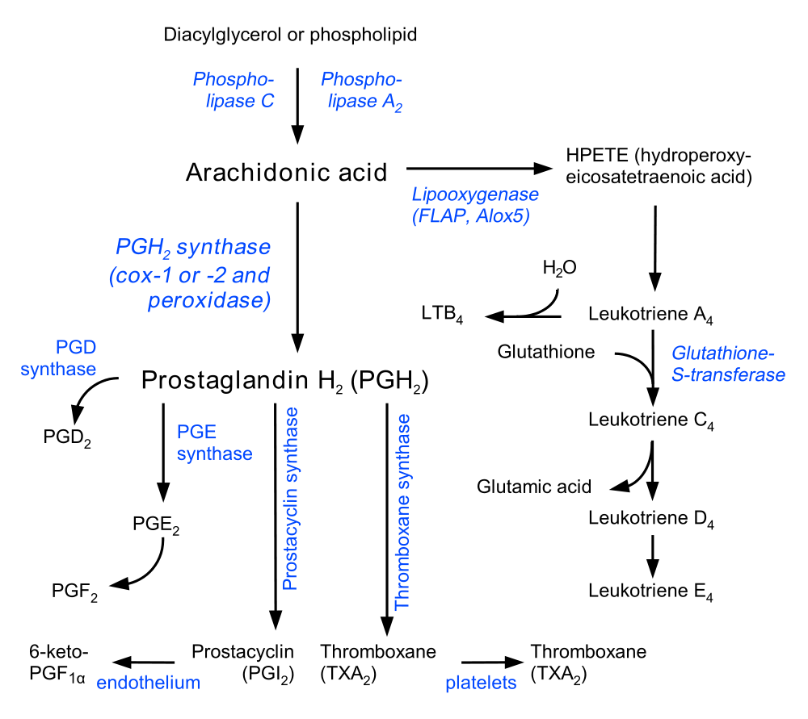
Biosynthetic pathways of eicosanoids

Slide 18
CONT’
Eicosanoid biosynthesis begins when cell is activated by mechanical trauma, cytokines, growth factors or other stimuli.
The stimulus may even be an eicosanoid from a neighboring cell.
The stimulus triggers the release of a phospholipase at the cell membrane.
The phospholipase travels to the nuclear membrane where it catalyses hydrolysis of a phospholipid or diacylglycerol.
The phospholipases that act on phospholipids and diacylglycerols are A2 and C respectively.
The actions of phospholipase free 20-carbon essentail fatty acids that form the backbones for eicosanoid synthesis.

Slide 19
CONT’
In fig. above, an intermediate arachidonic acid is created from either phospholipid via action of phospholipase A₂ or diacylglycerol via action of phospholipase C.
Arachidonic acid is then brought to either the cyclooxygenase pathway or the lipooxygenase pathway to form either prostaglandin and thromboxane or leukotrienes respectively.
The cyclooxygenase pathway produces thromboxane, prostacyclin and prostaglandins D₂, E₂ and F₂.
Alternatively, the lipooxygenase pathway is active in leukocytes and macrophages and synthesizes the leukotrienes.

Slide 20
CONT’
Prostaglandins are produced following the sequential oxidation of Gamma-linolenic acid (GLA), Arachidonic acid (AA) or eicosapentaenoic acid (EPA) by cyclooxygenases (COX-1 and COX-2) and terminal prostaglandin synthases.
COX-1 is responsible for the baseline levels of prostaglandins and COX-2 produces prostaglandins through stimulation.
Prostaglandin levels are increased by COX-2 in scenarios of inflammation.

Slide 21
.
Table 2: Effects of eicosanoids
Type of eicosanoid | Effects on tissues
Prostaglandins | Vasodilatation Inhibition of platelet aggregation Bronchodilation and/or bronchoconstriction GIT smooth muscle contraction Lowers gastric acid secretion Increases gastric mucus secretion Contraction of pregnant uterus Inhibition of lipolysis Increases autoimmune neurotransmitters like histamine Increases platelet response to their agonists and atherothrombosis in vivo
Thromboxane, TXA₂ | Thromboxane is a vasoconstrictor and a potent hypertensive agent. It facilitates platelet aggregation. NB: It is in homeostatic balance with prostacyclin (PGI_{2),} a related compound, with opposite effects.
Prostacyclin, PGI₂ | -Prostacyclin chiefly prevents formation of the platelet plug involved in blood clot formation. It is also an effective vasodilator.
Leukotrienes | They trigger and sustain contractions in the smooth muscles lining the trachea (specifically leukotriene D₄). Their overproduction is a major cause of inflammation in asthma and allergic rhinitis. Some such as LTB₄ have a chemotactic effect on migrating neutrophils, and as such help to bring the necessary cells to the tissue during immune response Leukotrienes also have a powerful effect in bronchoconstriction and increase vascular permeability.

Slide 22
Clinical use of eicosanoids
By virtue of their actions, eicosanoids (and their derivatives and antagonists) are widely used in clinical practice.
Non-steroidal anti-inflammatory drugs (NSAIDs), such as aspirin and brufen and its derivatives inhibit enzymes (especially cyclooxygenases) involved in the synthesis of eicosanoids.
This inhibits formation of prostaglandins involved in fever, pain and inflammation. In addition, aspirin also inhibits blood clotting by blocking thromboxane formation in platelets (also thrombocytes).
Prostaglandins are used in induction of labour due to their effect on smooth muscle of uterus.

Slide 23
CONT’
Leukotriene antagonists are used in the management of asthma and other allergic conditions
Metabolism of cholesterol
Cholesterol in our bodies is derived from the diet and also from synthesis within our bodies.
a) Biosynthesis of cholesterol
Cholesterol is an extremely important biological molecule that has roles in membrane structure as well as being a precursor for the synthesis of the steroid hormones and bile acids.
Cholesterol is synthesized in the cell cytosol and endoplasmic reticulum from acetyl CoA.

Slide 24
CONT’
The liver and intestine account each for 10% of the total cholesterol synthesized in the body.
Almost all tissues containing nucleated cells can synthesize cholesterol
The process of cholesterol synthesis has five major steps:
Acetyl-CoAs are converted to 3-hydroxy-3-methylglutaryl-CoA (HMG-CoA)
HMG-CoA is converted to mevalonate by HMG-CoA reductase (HMGR).
Mevalonate is converted to the isoprene based molecule, isopentenyl pyrophosphate (IPP), with the concomitant loss of CO₂
IPP is converted to squalene
Lastly, squalene is converted to cholesterol through a cyclization process.

Slide 25
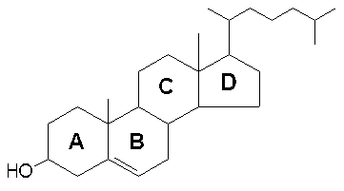
Structure of cholestrol

Slide 26
CONT’
Both the dietary cholesterol and that synthesized in the body cells are transported through the circulation in lipoprotein particles.
Lipoproteins also transport cholesteryl esters, the form in which cholesterol is stored in cells.
b) Regulation of cholesterol synthesis
Normal healthy adults synthesize cholesterol at a rate of approximately 1g/day and consume approximately 0.3g/day.
A relatively constant level of cholesterol in the blood (150–200 mg/dL) is

Slide 27
CONT’
maintained primarily by controlling the level of synthesis by the cells.
The level of cholesterol synthesis is regulated in part by the dietary intake of cholesterol.
Cholesterol from both diet and synthesis is utilized in the formation of membranes and in the synthesis of the steroid hormones and bile acids.
The greatest proportion of cholesterol is used in bile acid synthesis.

Slide 28
Why should cholesterol synthesis be regulated and how is it achieved?
The synthesis and utilization of cholesterol must be tightly regulated in order to prevent over-accumulation and abnormal deposition within the body.
Of particular importance clinically is the abnormal deposition of cholesterol and cholesterol-rich lipoproteins in the coronary arteries. Such deposition, eventually leading to atherosclerosis, is the leading contributory factor in diseases of the coronary arteries.
The cellular supply of cholesterol is maintained at a steady level by three distinct mechanisms:
Regulation of HMG CoA reductase activity and concentrations.

Slide 29
CONT’
Regulation of HMGR activity is the primary means for controlling the level of cholesterol biosynthesis.
The enzyme is controlled by four distinct mechanisms: feed-back inhibition, control of gene expression, rate of enzyme degradation and phosphorylation-dephosphorylation.
The first control mechanism is exerted by cholesterol itself.
Cholesterol acts as a feed-back inhibitor of pre-existing HMGR as well as inducing rapid degradation of the enzyme.

Slide 30
c) Transport of cholesterol
Cholesterol is transported in the plasma predominantly as cholesteryl esters associated with lipoproteins.
Dietary cholesterol is transported from the small intestine to the liver within chylomicrons.
Cholesterol synthesized by the liver, as well as any dietary cholesterol in the liver that exceeds hepatic needs, is transported in the serum within low density lipoproteins (LDLs).
The liver synthesizes very low density lipoproteins (VLDLs) which are converted to LDLs through the action of endothelial cell-associated lipoprotein lipase.

Slide 31
CONT’
Cholesterol found in plasma membranes can be extracted by high density lipoproteins (HDLs) and esterified by a HDL-associated enzyme.
The cholesterol acquired from peripheral tissues by HDLs can then be transferred to VLDLs and LDLs via the action of cholesteryl ester transfer protein which is associated with HDLs.
Reverse cholesterol transport allows peripheral cholesterol to be returned to the liver in LDLs.
Ultimately, cholesterol is excreted in the bile as free cholesterol or as bile salts following conversion to bile acids in the liver.

Slide 32
N/B:Cholesterol lowering drugs
Some anticholesterolaemic drugs like Simvastatin and Lovastatin are fungi-derived HMG-CoA reductase (HMGR) inhibitors and are members of the family of drugs referred to as the statins.
The net result of treatment is an increased cellular uptake of LDLs, since the intracellular synthesis of cholesterol is inhibited and cells are therefore dependent on extracellular sources of cholesterol.
However, since mevalonate (the product of the HMG-CoA reductase reaction) is required for the synthesis of other important isoprenoid compounds besides cholesterol, long-term treatments carry some risk of toxicity.

Slide 33
d) Catabolism of cholesterol
Intestinal Bacteria converts cholesterol to coprostanol which is excreted in faeces.
Cholesterol breaks down to bile acids cholic acid and chenodeoxycholic acid.
The bile acids combine with sodium and potassium to form bile salts.

Slide 34
AMINO ACID METABOLISM
Overview of amino acid degradation
All amino acids contain at least one nitrogen atom, which forms their α-amino group.
This nitrogen has no use in energy metabolism and has to be eliminated.
There are two key processes in metabolic nitrogen elimination:
Transamination removes the α-amino group from one amino acid and transfers it to α-ketoglutarate.
This leads to the accumulation of glutamate.
The release of nitrogen from glutamate and its conversion to urea.
This is accomplished by the urea cycle in the liver.

Slide 35
CONT’
Several amino acids e.g. arginine, asparagine, glutamine, histidine, lysine, proline and tryptophan do contain additional nitrogen atoms in their side chains.
For these, adapter pathways exist that ultimately also feed the nitrogen into the urea cycle for ultimate elimination.
Removal of nitrogen is an early step in amino acid degradation and leaves behind the carbon skeleton.
The structure of the carbon skeleton is different for each amino acid, and accordingly each amino acid has its specific pathway of degradation.
However, they can be grouped into two broad classes.

Slide 36
CONT’
Those amino acids that can be converted to intermediates of the TCA cycle or to pyruvate are called glucogenic amino acids, since they can contribute to the synthesis of glucose (gluconeogenesis).
Those that yield acetoacetate are called ketogenic, since acetoacetate is one of the two ketone bodies.
The degradation of the carbon skeletons of 20 amino acids converges to just seven metabolic intermediates namely: Pyruvate, Succinyl CoA, Acetyl CoA, Fumarate, Acetoacetyl CoA, Oxaloacetate and α-Ketoglutarate

Slide 37
Transamination
Transamination is the major process for removing nitrogen from amino acids.
Most of the amino acids undergo transamination except lysine and threonine (aminotransferases exist for all amino acids except threonine and lysine).
In most instances, the nitrogen is transferred as an amino group from the original amino acid to α-ketoglutarate, forming glutamate, whereas the original amino acid is converted to its corresponding α-ketoacid.
For example, the amino acid aspartate can be transaminated to form its corresponding α-ketoacid, oxaloacetate.
In the process, the amino group is transferred to α-ketoglutarate, which is converted to its corresponding amino acid, glutamate.

Slide 38
CONT’
The enzymes involved in transamination are called transaminases or aminotransferases.
There are several different aminotransferases, each of which is specific for an individual amino acid or for a group of chemically similar ones.
For most of these reactions, α-ketoglutarate and glutamate serve as one of the α-ketoacid and amino acid pairs.
The reactions use pyridoxal phosphate (PLP) as a cofactor. Transamination is freely reversible; therefore, both glutamate and α-ketoglutarate are substrates of every single transaminase.

Slide 39
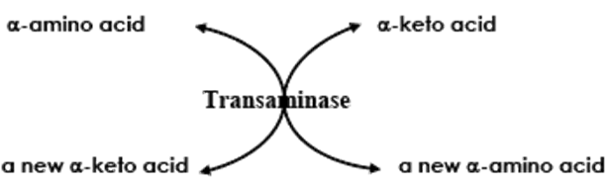
General reaction in transamination.

Slide 40
Transaminases of clinical significance
Alanine transaminase (ALT) also called as glutamate pyruvate transaminase (GPT) and Aspartate transaminase (AST) also called as glutamate oxaloacetate transaminase (GOT) are the two most important transaminases of clinical importance.
These enzymes are abundant in heart and liver they are released as part of cell injury that occurs in myocardial infarction (MI), infectious hepatitis and damage to either organ.
An elevated level of both SGOT and SGPT (S for Serum) indicates damage to the Liver.

Slide 41
CONT’
However a rise in SGOT accompanied by only a moderate rise in SGPT suggests damage to heart muscle, skeletal muscle, kidney etc.
Assays of these enzyme activities in blood serum can be used both in diagnosis and in monitoring the progress of a patient during treatment.

Slide 42
Deamination of amino acids
Transamination does not result in net deamination, since one amino acid is replaced by another amino acid.
The function of transamination is to funnel the amino nitrogen into one or a few amino acids.
There are other pathways that are closely related to transamination. These are oxidative and non-oxidative deamination.
A) Oxidative deamination
For glutamate to play a role in the net conversion of amino groups to ammonia, a mechanism for glutamate deamination is needed so that α-ketoglutarate can be regenerated for further transamination.

Slide 43
CONT’
The generation is accomplished by the oxidative deamination of glutamate by glutamate dehydrogenase.
Glutamate is oxidatively deaminated in the mitochondrion by glutamate dehydrogenase.
NAD+ or NADP+ functions as the coenzyme.
Oxidation is thought to occur with the transfer of a hydride ion from glutamate's carbon to NAD(P)+ to form α-iminoglutarate, which is then hydrolysed to α-ketoglutarate and ammonia.
The ammonia produced is then converted to urea in mammals.
Most ammonia results from the deamination of a single amino acid: glutamate, via the Glutamate dehydrogenase reaction.
The reaction is reversible as shown in Fig.below

Slide 44
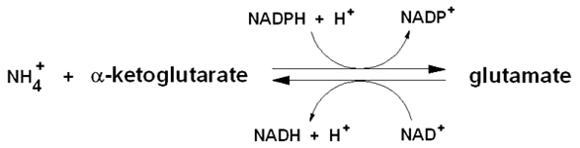
CONT’

Slide 45
CONT’
As seen in Fig. above, the enzyme glutamate dehydrogenase utilizes both nicotinamide nucleotide cofactors; NAD⁺ in the direction of nitrogen liberation in the form of ammonia and and alpha-ketoglutarate (an intermediate of TCA cycle; and NADP⁺ for nitrogen incorporation into glutamate, forming one of the 20 amino acids for protein synthesis.
The ammonia thus formed is converted to glutamine by glutamine synthase and transported to kidney tubule cells.
There the glutamine is sequentially deamidated by glutaminase and deaminated by kidney glutamate dehydrogenase.
The ammonia produced in the latter two reactions is excreted as NH4+ in the urine, where it helps maintain urine pH in the normal range of pH 4 to pH 8.

Slide 46
b) Non-oxidative deamination
Amino acids such as serine and histidine are deaminated non-oxidatively. The other reactions involved in the catabolism of amino acids are decarboxylation, transulfuration, desulfuration, dehydration etc.
The decarboxylation process is important since the products of decarboxylation reactions give rise to physiologically active amines.
In decarboxylation, the responsible enzymes, amino acid decarboxylases are pyridoxal phosphate-dependent.
Pyridoxal phosphate forms a Schiff's base with the amino acid so as to stabilise the α-carbanion formed by the cleavage of bond between carboxyl and α-carbon atom.

Slide 47
CONT’
The physiologically active amines epinephrine, nor-epinephrine, dopamine, serotonin, γ-amino butyrate and histamine are formed through decarboxylation of the corresponding precursor amino acids.

Slide 48
The urea cycle
The normal human adult is in nitrogen balance; that is, the amount of nitrogen ingested each day, mainly in the form of dietary protein, is equal to the amount of nitrogen excreted.
The major nitrogenous excretory product is urea, which exits from the body in the urine.
This innocuous compound, produced mainly in the liver by the urea cycle, serves as the disposal form of ammonia, which is toxic, particularly to the central nervous system.
Normally, little ammonia (or NH₄⁺) is present in the blood.

Slide 49
CONT’
Ammonia is rapidly removed from the blood and converted to urea by the liver.
Nitrogen travels in the blood mainly in amino acids, particularly alanine and glutamine.
In summary the urea cycle occurs thus: Nitrogen enters the urea cycle as NH₄⁺ and aspartate.
NH₄⁺ forms carbamoyl phosphate, which reacts with ornithine to form citrulline.
Ornithine is the compound that both initiates and is regenerated by the cycle, similar to oxaloacetate in the tricarboxylic acid (TCA) cycle.

Slide 50
CONT’
Aspartate reacts with citrulline, eventually donating its nitrogen for urea formation.
Arginine is formed in two successive steps.
Cleavage of arginine by arginase releases urea and regenerates ornithine

Slide 51
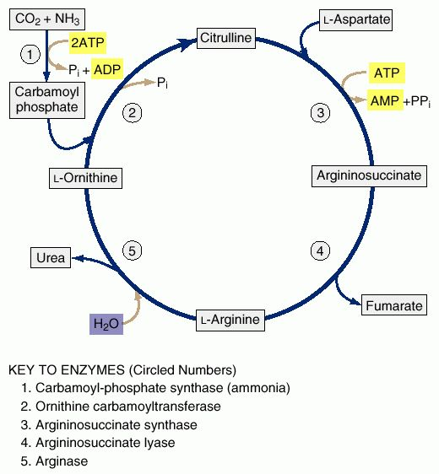
The Urea Cycle

Slide 52
Reactions of the urea cycle
Synthesis of Carbamoyl Phosphate
In the first step of the urea cycle, NH₄⁺, bicarbonate, and ATP react to form carbamoyl phosphate.
The cleavage of two ATPs is required to form the high-energy phosphate bond of carbamoyl phosphate.
Carbamoyl phosphate synthetase I (CPSI), the enzyme that catalyzes this first step of the urea cycle, is found mainly in mitochondria of the liver and intestine.

Slide 53
CONT’
2. Production of Arginine by the Urea Cycle
Carbamoyl phosphate reacts with ornithine to form citrulline.
The high-energy phosphate bond of carbamoyl phosphate provides the energy required for this reaction, which occurs in mitochondria and is catalyzed by ornithine transcarbamoylase.
The product, citrulline, is transported across the mitochondrial membranes in exchange for cytoplasmic ornithine and enters the cytosol.
In the cytosol, citrulline reacts with aspartate, the second source of nitrogen for urea synthesis, to produce argininosuccinate.
This reaction, catalyzed by argininosuccinate synthetase, is driven by the hydrolysis of ATP to adenosine monophosphate (AMP) and pyrophosphate.
Aspartate is produced by transamination of oxaloacetate.

Slide 54
CONT’
Argininosuccinate is in turn cleaved by argininosuccinate lyase to form fumarate and arginine.
Fumarate is produced from the carbons of argininosuccinate provided by aspartate.
Fumarate is converted to malate (using cytoplasmic fumarase), which is used either for the synthesis of glucose by the gluconeogenic pathway or for the regeneration of oxaloacetate by cytoplasmic reactions similar to those observed in the TCA cycle.
The oxaloacetate that is formed is transaminated to generate the aspartate that carries nitrogen into the urea cycle. Thus, the carbons of fumarate can be recycled to aspartate.

Slide 55
CONT,
3. Cleavage of Arginine to Produce Urea
Arginine, which contains nitrogens derived from NH₄⁺ and aspartate, is cleaved by arginase, producing urea and regenerating ornithine.
Urea is produced from the guanidinium group on the side chain of arginine.
The portion of arginine originally derived from ornithine is reconverted to ornithine.
The reactions by which citrulline is converted to arginine and arginine is cleaved to produce urea occur in the cytosol.
Ornithine, the other product of the arginase reaction, is

Slide 56
CONT’
transported into the mitochondrion in exchange for citrulline, where it can react with carbamoyl phosphate, initiating another round of the cycle.

Slide 57
Regulation of the urea cycle
The human liver has a vast capacity to convert amino acid nitrogen to urea, thereby preventing toxic effects from ammonia, which would otherwise accumulate.
In general, the urea cycle is regulated by substrate availability; the higher the rate of ammonia production, the higher the rate of urea formation.
Regulation by substrate availability is a general characteristic of disposal pathways, such as the urea cycle, which remove toxic compounds from the body.
his is a type of feed-forward regulation, in contrast to the feedback regulation characteristic of pathways that produce functional end products.
Two other types of regulation control the urea cycle: allosteric activation of CPSI by N-acetylglutamate (NAG) and induction and

Slide 58
CONT’
repression of the synthesis of urea cycle enzymes. NAG is formed specifically to activate CPSI; it has no other known function in mammals.
The synthesis of NAG from acetyl CoA and glutamate is stimulated by arginine. Thus, as arginine levels increase within the liver, two important reactions are stimulated.
The first is the synthesis of NAG, which increases the rate at which carbamoyl phosphate is produced.
The second is to produce more ornithine (via the arginase reaction), such that the cycle can operate more rapidly.
The induction of urea cycle enzymes occurs in response to conditions that require increased protein metabolism

Slide 59
CONT’
, such as a high-protein diet or prolonged fasting.
In both of these physiological states, as amino acid carbon is converted to glucose, amino acid nitrogen is converted to urea. The ability of a high-protein diet to increase urea cycle enzyme levels is another type of feed-forward regulation.

Slide 60
Energetics of the urea cycle
If the urea cycle is considered in isolation, the synthesis of one molecule of urea requires four high energy phosphate groups. In reference to Figure 17, it is shown that:
2 ATPs are used up to make up carbamoyl Phosphate
1 ATP and two High- energy bonds are used to make up Arginosuccinate
Here it should be noted that any reaction that creates a new C-N bond costs one ATP.
However, the urea cycle also cause a net conversion of oxaloacetate to fumarate via Aspartate and regeneration of oxaloacetate produces NADH in the malate dehydrogenase reaction.
You may recall that each NADH molecule can generate up to 3 ATPs in oxidative phosphorylation and electron transport.
Therefore the overall equation of the urea cycle is:

Slide 61
CONT’
NH₄⁺ + HCO₃⁻ +3ATPs + H₂O → Urea +2 ADP + 4Pi + AMP + 5H⁺
Discuss disoders of urea-cycle.
END

